Slide 1


Big Mountain Resort
Presented by: Mayra Chavez

Slide 2
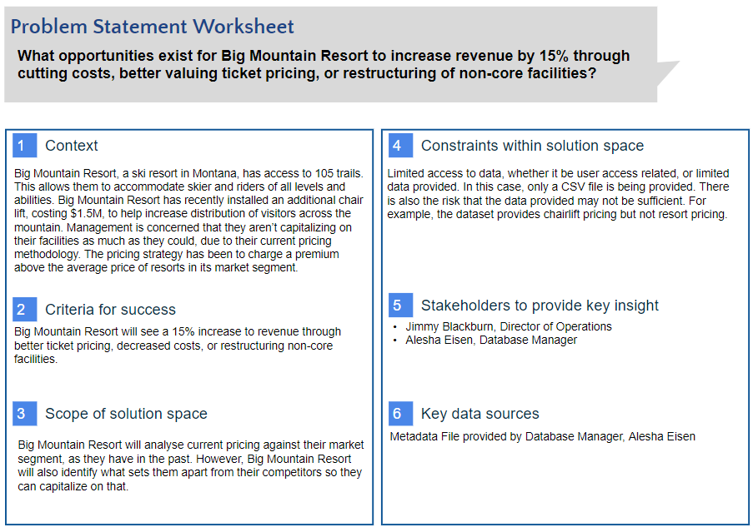

Slide 3
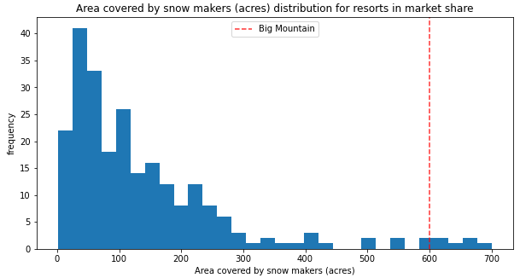
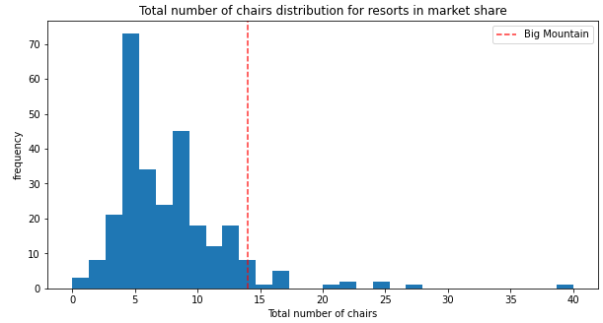
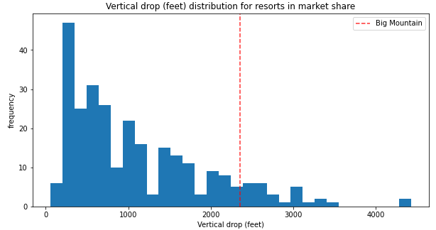
Big Mountain Resort Has:
Some of the best area covered by snow makers.
Competitive vertical drops.
Amongst the highest number of total chairs.

Slide 4
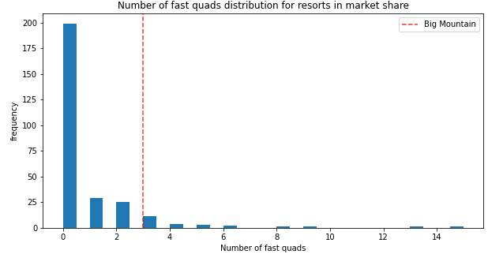
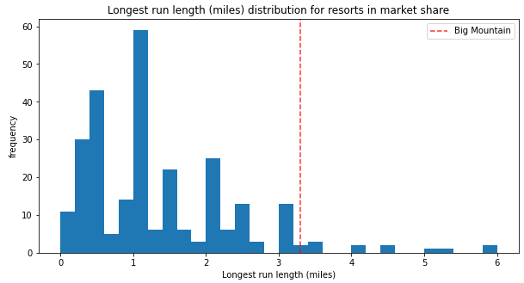
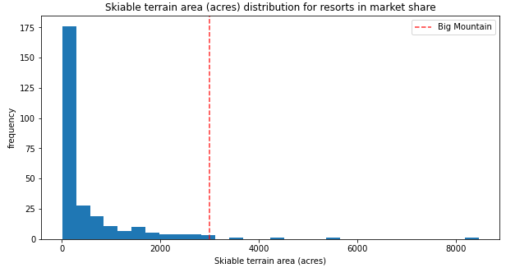
Big Mountain Resort:
Has 3 fast quads, which puts it high up the league because most resorts have no fast quads.
Compares well for the # of runs and has one of the longest runs.
Is amongst the resorts with the largest amount of skiable terrain.

Slide 5
Modeling Scenarios
The business has shortlisted some options:
Permanently closing down up to 10 of the least used runs. This doesn't impact any other resort statistics.
Increase the vertical drop by adding a run to a point 150 feet lower down but requiring the installation of an additional chair lift to bring skiers back up, without additional snow making coverage
Same as number 2, but adding 2 acres of snow making cover
Increase the longest run by 0.2 mile to boast 3.5 miles length, requiring an additional snow making coverage of 4 acres
The expected number of visitors over the season is 350,000 and, on average, visitors ski for five days.

Slide 6

Conclusion
Analysis has determined that Big Mountain Resort is undervaluing ticket prices.
Model recommends increase in ticket pricing from $81.00 to $95.87

